Slide 1
Module 6.5 Finding vulnerabilities

Slide 2






Survey of Web Vulnerability Tools
Local Remote
>$100K total retail price

Slide 3
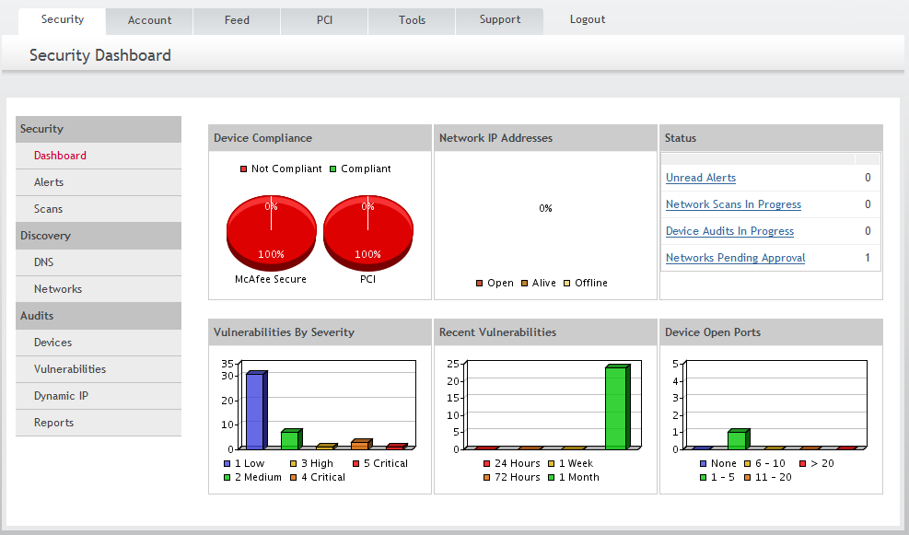
Example scanner UI

Slide 4
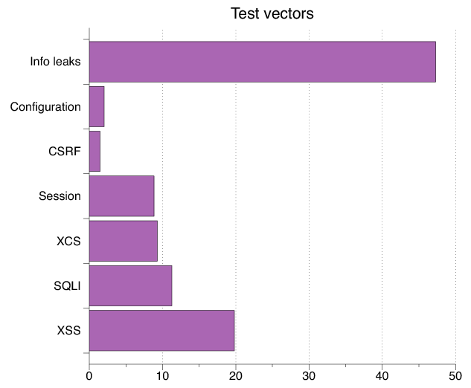
Test Vectors By Category
Test Vector Percentage Distribution

Slide 5
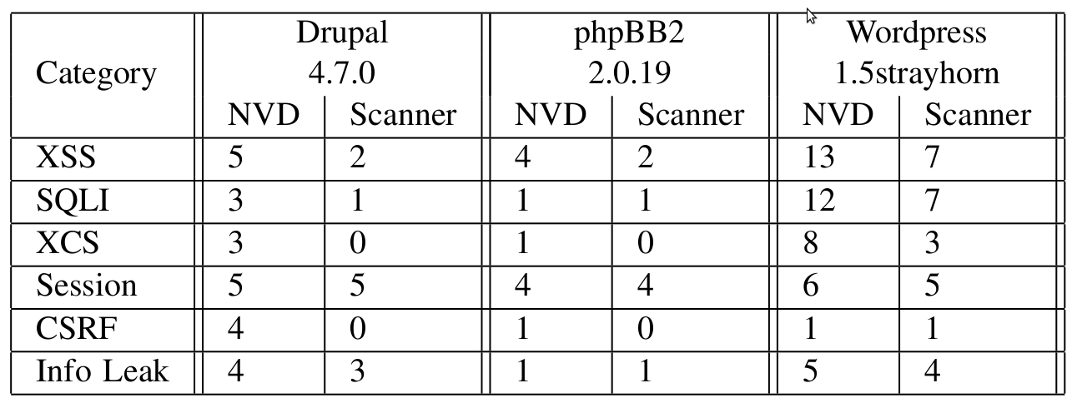
Detecting Known Vulnerabilities
Vulnerabilities for
previous versions of Drupal, phpBB2, and WordPress
Good: Info leak, Session
Decent: XSS/SQLI
Poor: XCS, CSRF (low vector count?)

Slide 6
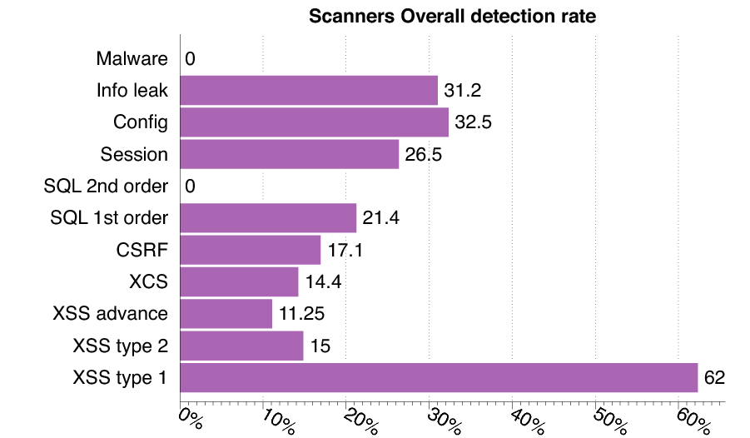
Vulnerability Detection
Notes:
Examples of Second Order SQL Injection Attack
Suppose you have a Web-based application which stores usernames alongside other session information. Given a session identifier such as a cookie you want to retrieve the current username and then use it in turn to retrieve some user information. You might therefore have code for an "Update User Profile" screen somewhat similar to the following: execute immediate 'SELECT username FROM sessiontable WHERE session ='''||sessionid||'''' into username; execute immediate 'SELECT ssn FROM users WHERE username='''||username||'''' into ssn; This will be injectable if the attacker had earlier on the "Create Account" screen created a username such as: XXX' OR username='JANE Which creates the query: SELECT ssn FROM users WHERE username='XXX’ OR username='JANE' If the user XXX does not exist, the attacker has successfully retrieved Jane’s social security number.
The attacker can create malicious database objects such as a function called as part of an API, or a maliciously named table by using double quotation marks to introduce dangerous constructs. For example, an attacker can create a table using a table name such as "tab') or 1=1--", which can be exploited later in a second order SQL injection attack
consumer electronics are particularly vulnerable to a nasty form of persistent XSS where a non-web channel such as NFS or SNMP is used to inject a malicious script. This script is later used to attack an unsuspecting user who connects to the device's web server. We refer to web attacks which are mounted through a non-web channel as cross channel script- ing (XCS). We propose a client-side defense against certain XCS which we implement as a browser extension.

